Slide 1
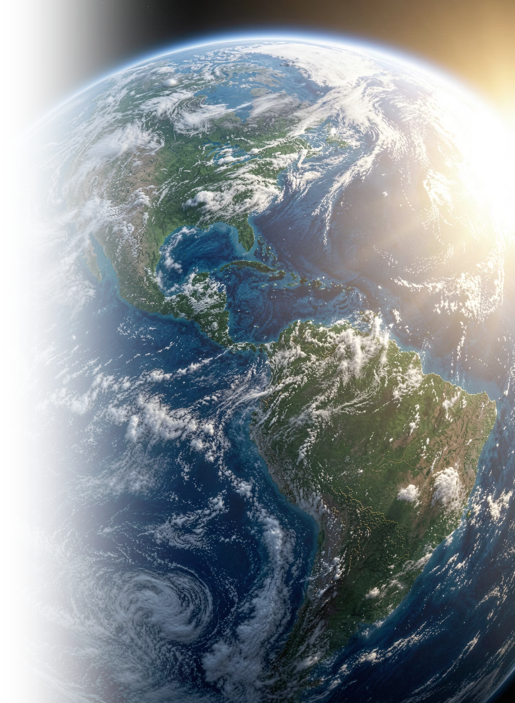

Climate Change: Our Planet, Our Future
A science-based guide for high school students — understanding the crisis, the causes, and what we can do about it.
Speaker Notes: Welcome students and set a positive, curious tone. This presentation covers the science of climate change in clear, accessible language. It is designed to inform and empower — not overwhelm. Encourage students to ask questions throughout. Key themes include: what climate change is, why it is happening, its real-world impacts, and what actions — big and small — can make a difference. Total presentation time: approximately 45–60 minutes with discussion.

Slide 2
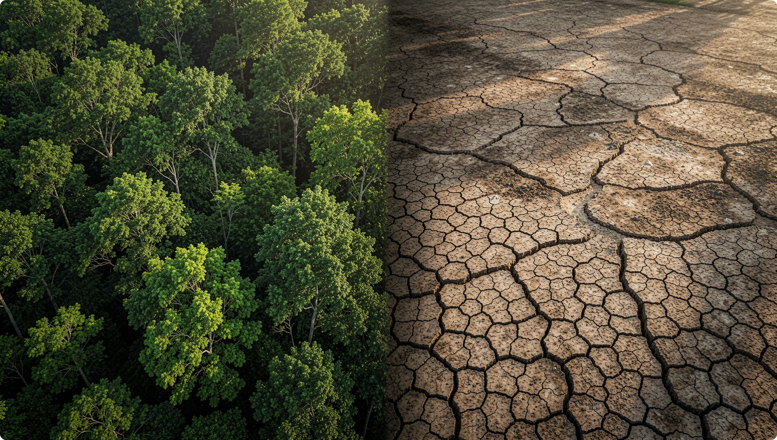

THE BASICS
What Is Climate Change?
Climate change refers to long-term shifts in global temperatures and weather patterns. While some variation is natural, since the 1800s, human activities have been the primary driver.
Burning fossil fuels releases greenhouse gases
These gases trap heat in the atmosphere
The planet warms — disrupting weather, oceans, and ecosystems
Source: NASA Global Climate Change
Speaker Notes: Distinguish "climate" from "weather" — weather is short-term (today's forecast), while climate is the long-term average of weather over decades. A helpful analogy: weather is your outfit today; climate is your entire wardrobe. The Industrial Revolution (circa 1800s) marks the turning point when human activity began significantly altering atmospheric composition. This slide sets the foundation for everything that follows.

Slide 3


THE SCIENCE
The Greenhouse Effect
Sunlight
Earth Radiates
Gases Trap Heat
Human Boost
The greenhouse effect is natural and necessary — without it, Earth would be frozen. The problem is that human activities have supercharged it, trapping far more heat than the planet can handle.
Source: EPA Climate Change Science
Speaker Notes: Use the car-in-the-sunshine analogy: sunlight enters through the windows, warms the interior, but the heat cannot escape — the car gets hotter and hotter. That is essentially what greenhouse gases do to our atmosphere. Emphasize that the greenhouse effect itself is not bad; it is what keeps Earth habitable. The crisis is the excess caused by human emissions. Invite students to think about what "too much of a good thing" looks like in this context.

Slide 4

THE CAUSES
What's Driving Climate Change?
🏭 Fossil Fuels
🌳 Deforestation
Coal, oil, and gas burned for energy are the #1 source of CO₂ emissions worldwide.
Trees absorb CO₂. When forests are cut down, that stored carbon is released into the air.
🐄 Agriculture
🚗 Transportation
Livestock produce methane, a greenhouse gas 25× more powerful than CO₂.
Cars, trucks, ships, and planes account for nearly 16% of global emissions.
Source: IPCC Sixth Assessment Report, 2021
Speaker Notes: Walk through each driver one at a time. Fossil fuels are the dominant cause — about 75% of global CO₂ comes from burning them. Deforestation is especially significant in the Amazon and Southeast Asia. For agriculture, note that methane comes from livestock digestion and rice paddies. Transportation is a major contributor in developed countries. Ask students: Which of these do you interact with every day? This makes the issue personal and relatable.

Slide 5

THE EVIDENCE
The Numbers Don't Lie
1.2°C
420ppm
Temperature Rise
CO₂ Concentration
Global average temperature increase since pre-industrial times
Highest level in over 800,000 years
3.7mm
90%
Sea Level Rise
Ocean Heat
Average annual rise — accelerating every decade
Of excess heat trapped is absorbed by our oceans
Sources: NASA, NOAA, IPCC AR6 (2021)
Speaker Notes: These four numbers tell the story of climate change in data form. 1.2°C may sound small, but on a global scale, it represents an enormous amount of energy. For context, the difference between today and the last Ice Age was only about 5°C. CO₂ at 420 ppm is unprecedented in human history — previous peaks were around 300 ppm. Sea level rise seems slow but is accelerating, threatening coastal communities. The ocean absorbing 90% of heat explains why marine ecosystems are under such stress. Consider asking: Which of these numbers surprises you most?

Slide 6
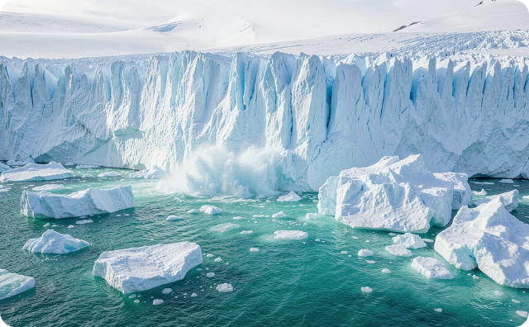
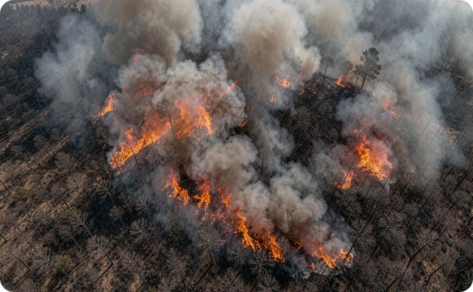
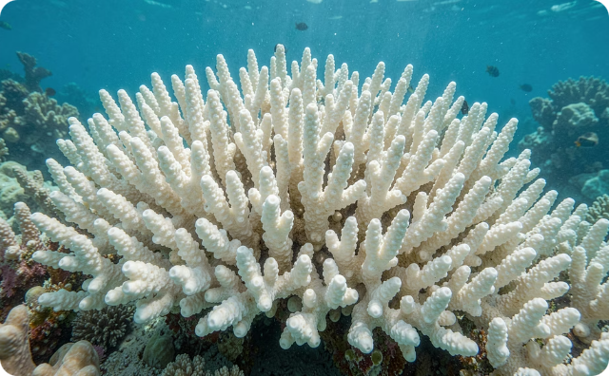

THE IMPACTS
Climate Change Is Already Here
Melting Ice & Rising Seas
Extreme Weather
Ocean Crisis
Glaciers and ice sheets are disappearing, threatening coastal cities worldwide.
Heatwaves, floods, droughts, and hurricanes are becoming more frequent and intense.
Warmer, more acidic oceans are destroying coral reefs and marine ecosystems.
Source: IPCC Sixth Assessment Report, 2021
Speaker Notes: These are not future predictions — they are happening now. Melting ice contributes to sea level rise, which already affects places like Miami, Bangladesh, and Pacific Island nations. Extreme weather events have increased in both frequency and severity; for example, the 2023 Canadian wildfires and Pakistan floods were linked to climate change. Ocean acidification (caused by absorbed CO₂) is bleaching coral reefs — the Great Barrier Reef has suffered multiple mass bleaching events. Ask students: Have you or someone you know been affected by extreme weather?

Slide 7
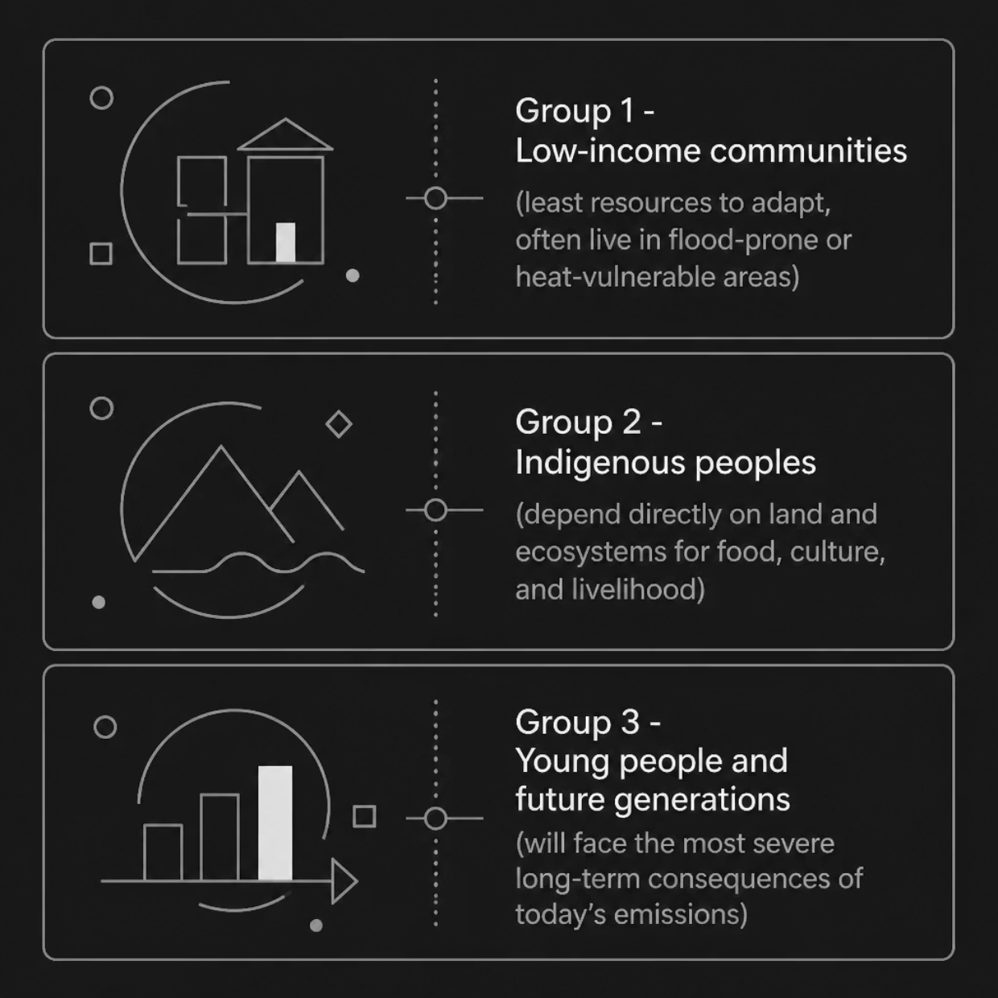

THE HUMAN COST
Who Is Most Affected?
Climate change is not just an environmental issue — it is a social justice issue. The communities that contributed the least to emissions often face the harshest consequences.
Small island nations face complete submersion
Droughts threaten food security across Africa and Asia
Heatwaves disproportionately affect urban, low-income areas
Source: United Nations Framework Convention on Climate Change
Speaker Notes: This is a critical equity discussion. Countries in the Global South — like Bangladesh, Nigeria, and Pacific Island nations — emit very little CO₂ but suffer the worst flooding, droughts, and storms. Indigenous communities, from the Arctic to the Amazon, are losing traditional lands and ways of life. Young people will inherit the consequences of decisions made today. This framing helps students understand that climate action is also about fairness and responsibility. Encourage empathy and global thinking.

Slide 8




THE SOLUTIONS
We Have the Tools to Fix This
Renewable Energy
Nature-Based Solutions
Solar, wind, and hydropower can replace fossil fuels. Costs have dropped 90% since 2010.
Reforestation, wetland restoration, and sustainable farming absorb CO₂ and protect biodiversity.
Clean Transportation
Policy & Innovation
Electric vehicles, public transit, and walkable cities can slash emissions from transport.
Carbon pricing, clean energy standards, and green technology investment drive systemic change.
Source: International Energy Agency, 2023
Speaker Notes: This is the hope slide — emphasize that solutions exist and are scaling fast. Solar energy is now the cheapest electricity in history (IEA, 2020). Electric vehicles are becoming mainstream; many countries plan to ban new gas car sales by 2035–2040. Nature-based solutions are cost-effective and provide co-benefits like biodiversity and clean water. Policy matters: the Paris Agreement, carbon taxes, and clean energy subsidies are already shifting markets. Ask students: Which solution excites you most? Could you work in one of these fields?

Slide 9
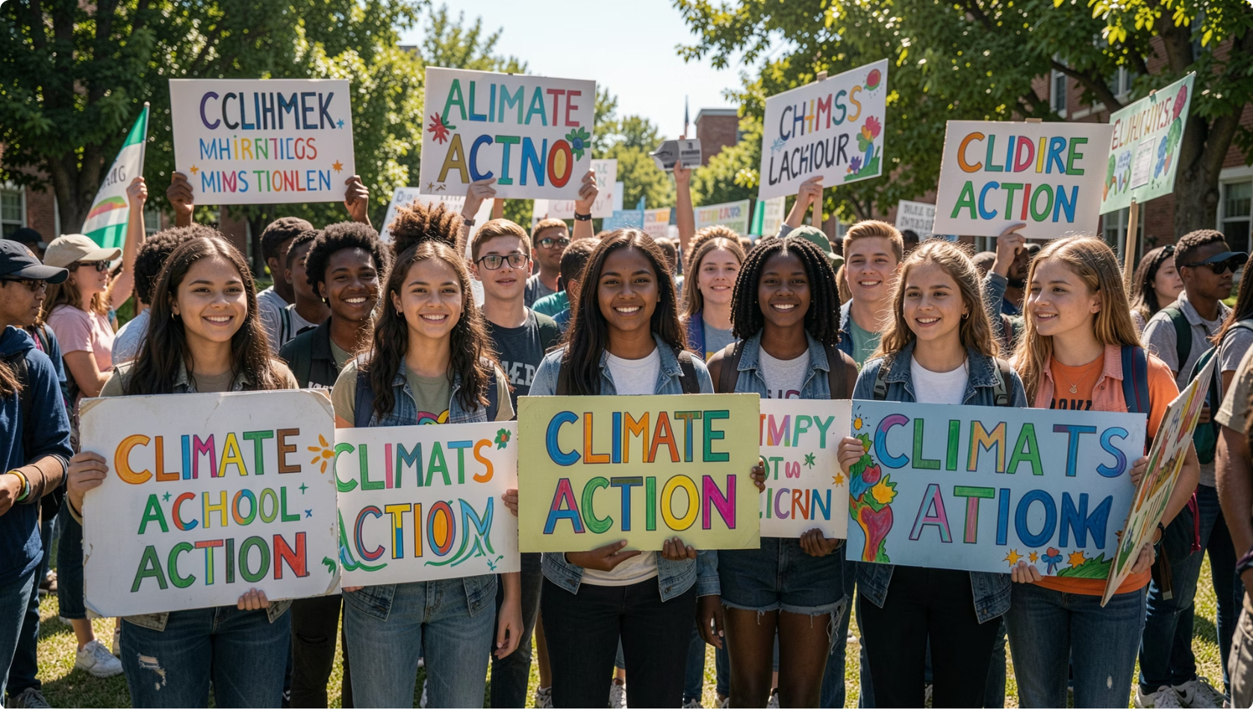


YOUR POWER
What Can You Do?
You don't have to wait to be an adult to make a difference. Young people are already leading the climate movement worldwide.
Source: UN Youth Climate Summit
Learn & Share
Act Locally
Use Your Voice
Stay informed and talk to friends and family about climate science.
Reduce waste, eat more plants, use public transport, and conserve energy.
Vote, join climate groups, and demand action from leaders and companies.
Speaker Notes: Empower students — they are not too young to matter. Greta Thunberg started her school strike at age 15. Youth-led organizations like Zero Hour, Fridays for Future, and the Sunrise Movement are shaping policy. Individual actions matter, but systemic change requires collective pressure. Encourage students to find their lane: science, art, policy, journalism, engineering, law — every field needs climate-literate people. Suggest local actions: joining an environmental club, attending a city council meeting, or starting a sustainability project at school.

Slide 10
KEY TAKEAWAYS
The Future Is Still Ours to Shape
🌍 It's Real
⚡ It's Urgent
Climate change is happening now, driven by human activity.
Every fraction of a degree matters. We must act this decade.
💡 It's Solvable
🙌 It's Yours
The technology and knowledge exist. What we need is will.
Your generation has the power — and the responsibility — to lead.
Sources: IPCC AR6, NASA Climate, UNFCCC, IEA 2023
Speaker Notes: Close with energy and optimism. Recap the four key messages: climate change is real, urgent, solvable, and this generation is uniquely positioned to drive change. Leave time for questions — students often have thoughtful ones about careers, personal choices, or global politics. Consider ending with a call to action: "What is one thing you will do differently after today?" Provide additional resources: NASA Climate Kids, Project Drawdown, the IPCC Summary for Policymakers (accessible version), and local environmental organizations. Thank students for their attention and engagement.

